Slide 1
Chapter 6: Mechanical Properties
ISSUES TO ADDRESS...
• Stress and strain: What are they and why are
they used instead of load and deformation?
• Elastic behavior: When loads are small, how much
deformation occurs? What materials deform least?
• Plastic behavior: At what point does permanent deformation occur? What materials are most resistant to permanent deformation?
• Toughness and ductility: What are they and how
do we measure them?

Slide 2
Elastic Deformation
1. Initial
2. Small load
3. Unload
bonds
stretch
return to
initial
δ
F
F
Linear-
elastic
Elastic means reversible!
Non-Linear-
elastic
δ

Slide 3
Plastic Deformation (Metals)
1. Initial
2. Small load
3. Unload
bonds
stretch
p
lanes
& planes
still
shear
sheared
δ
plastic
δ
elastic + plastic
F
F
Plastic means permanent!
linear
linear
elastic
elastic
δ
δ
plastic

Slide 4
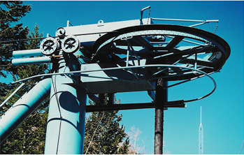
Common States of Stress
• Simple tension: cable
F
F
A
o
= cross sectional
area (when unloaded)
F
σ
=
σ
σ
A
o
• Torsion (a form of shear): drive shaft
Ski lift (photo courtesy P.M. Anderson)
M
F
s
A
o
A
c
F
s
τ
=
A
M
o
2R
In this case stress varies from center to surface of rod

Slide 5


OTHER COMMON STRESS STATES (1)
• Simple compression:
A
o
Canyon Bridge, Los Alamos, NM
(photo courtesy P.M. Anderson)
F
Note: compressive
structure member
(σ < 0 here).
σ
=
Balanced Rock, Arches
A
National Park
o
(photo courtesy P.M. Anderson)

Slide 6
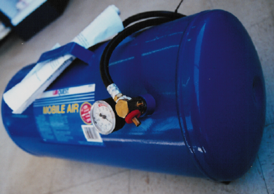
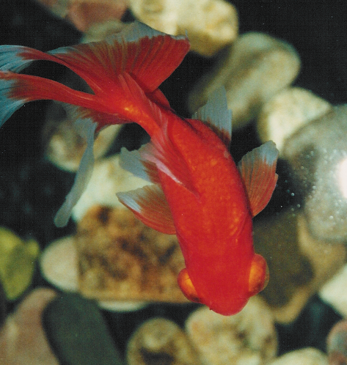
OTHER COMMON STRESS STATES (2)
• Bi-axial tension:
• Hydrostatic compression:
Pressurized tank
Fish under water
(photo courtesy
P.M. Anderson)
(photo courtesy
P.M. Anderson)
σ
> 0
θ
σ
> 0
σ < 0
z
h

Slide 7
Engineering Stress
• Tensile stress, σ:
• Shear stress, τ:
F
t
F
t
F
Area, A
Area, A
F
s
F
s
F
t
F
s
F
t
F
τ
=
F
t
lb
N
σ
=
=
f
or
A
o
A
in
2
m
2
o
original area
∴ Stress has units: N/m² or lb_{f}/in2
before loading

Slide 8
Engineering Strain
• Tensile strain:
• Lateral strain:
δ
/2
δ
−
δ
ε
=
ε
=
L
L
L
L
w
o
w
o
o
o
δ
L
/2
• Shear strain:
θ
Δx
γ = Δx/y = tan
θ
y
90º - θ
Strain is always
dimensionless.
90º

Slide 9
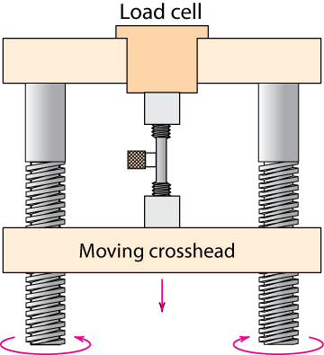
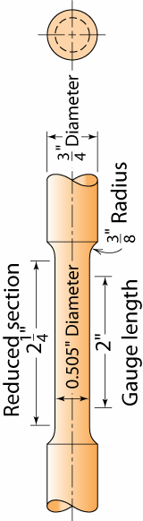
Stress-Strain Testing
• Typical tensile test machine
• Typical tensile specimen
Adapted from Fig. 6.2,
Callister 7e.
extensometer
specimen
gauge
length
Measure F, δ; convert to σ, ε; plot σ vs. ε

Slide 10
Linear Elastic Properties
• Modulus of Elasticity, E:
(also known as Young's modulus)
• Hooke's Law:
σ = E ε
σ
F
E
ε
Linear-
elastic
F
simple
tension
test

Slide 11
Poisson's ratio, ν
ε_{L}
• Poisson's ratio, ν:
ε
ν
=
−
L
ε
ε
metals: ν ~ 0.33 ceramics: ν ~ 0.25 polymers: ν ~ 0.40
-
ν
Units:
E: [GPa] or [psi]
ν: dimensionless
ν > 0.50 density increases
ν < 0.50 density decreases (voids form)

Slide 12
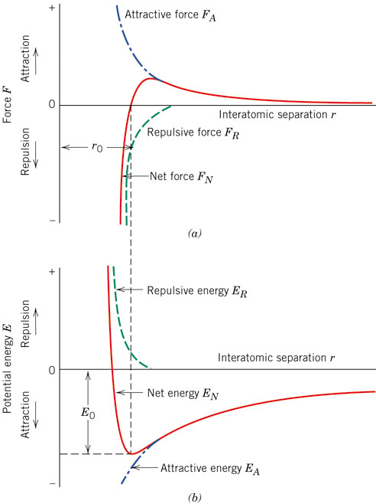
Energies and Forces

Slide 13
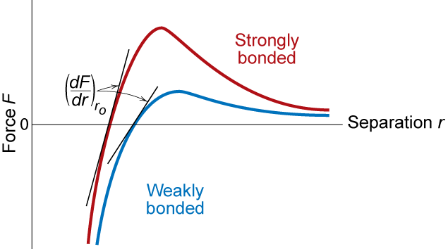
Mechanical Properties
Slope of stress strain plot (which is proportional to the elastic modulus) depends on bond strength
Adapted from Fig. 6.7,
Callister 7e.

Slide 14
Other Elastic Properties
τ
M
• Elastic Shear
modulus, G:
G
simple
torsion
test
γ
τ = G γ
M
• Elastic Bulk
modulus, K:
P
P
Δ
V
P
P
Δ
V
P = -
K
V
V
o
K
o
pressure
test: Init.
vol =V_{o}.
Vol chg.
= ΔV
• Special relations for isotropic materials:
E
E
G
=
K
=
2(1 + ν)
3(1 − 2ν)

Slide 15
Young’s Moduli: Comparison
Metals
Alloys
Graphite
Ceramics
Semicond
Composites
/fibers
Polymers
1200
10
00
Diamond
8
00
6
00
Si carbide
4
00
Tungsten
Al oxide
Carbon
fibers only
E(GPa)
Molybdenum
Si nitride
2
00
Steel, Ni
C
FRE(|| fibers)*
Tantalum
<111>
Platinum
Si crystal
A
ramid fibers only
10
0
Cu alloys
<100>
8
0
Zinc, Ti
Based on data in Table B2,
Callister 7e.
Composite data based on
reinforced epoxy with 60 vol%
of aligned
carbon (CFRE),
aramid (AFRE), or
glass (GFRE)
fibers.
Silver, Gold
Glass
-
soda
A
FRE(|| fibers)*
6
0
Aluminum
Glass fibers only
4
0
Magnesium,
G
FRE(|| fibers)*
Tin
10⁹ Pa
Concrete
2
0
GFRE*
CFRE
*
10
G
raphite
G
FRE( fibers)*
8
C
FRE( fibers)
*
6
AFRE( fibers)
*
4
Polyester
PET
PS
Epoxy only
2
PC
PP
1
HDP
E
0.8
0.6
PTF
E
Wood( grain)
0.4
0.2
LDPE

Slide 16
Plastic (Permanent) Deformation
(at lower temperatures, i.e. T < T_{melt}/3)
• Simple tension test:
Elastic+Plastic
engineering stress, σ
at larger stress
Elastic
initially
permanent (plastic)
after load is removed
ε_{p}
engineering strain, ε
plastic strain

Slide 17
Yield Strength, σ_{y}
• Stress at which noticeable plastic deformation has
occurred.
when ε_{p} = 0.002
tensile stress,
σ
σ_{y} = yield strength
Note: for 2 inch sample
ε = 0.002 = Δz/z
∴ Δz = 0.004 in
σ_{y}
engineering strain,
ε
ε
p
= 0.002
Adapted from Fig. 6.10 (a),
Callister 7e.

Slide 18
Alternative Definition of Yield Strength, σ_{y}
• Stress at which ε_{t}=0.005 total strain occurs
tensile stress,
σ
σ_{y} = yield strength
σ_{y}
Particularly useful for materials
with no well-defined initial
linear regime (some plastics)
ε
= 0.005
ε
t
engineering strain

Slide 19
Yield Strength : Comparison
Metals/
Graphite/
Composites/
Alloys
Ceramics/
Polymers
fibers
Semicond
2
0
00
Steel
(4140)
qt
Typically
σ_{y} ~ E/100
10
00
Ti
(5Al-2.5Sn)
a
(MPa)
W
(pure)
7
00
6
00
Cu
(71500)
cw
5
00
Mo (pure)
4
00
Steel
(4140)
a
y
Steel
(1020)
cd
σ
3
00
,
Room T values
Al
(6061)
ag
2
00
Steel
(1020)
hr
¨
Ti
(pure)
a
Ta
(pure)
hr
Hard to measure,
Based on data in Table B4,
Callister 7e.
a = annealed
hr = hot rolled
ag = aged
cd = cold drawn
cw = cold worked
qt = quenched & tempered
Cu
(71500)
Hard to measure
in tension, fracture usually occurs before yield.
since in tension, fracture usually occurs before yield.
in ceramic matrix and epoxy matrix composites, since
100
Yield strength,
dry
70
PC
60
Al
(6061)
a
Nylon 6,6
50
PET
humid
40
PVC
30
PP
H
DPE
20
Tin (pure)
LDPE
10

Slide 20
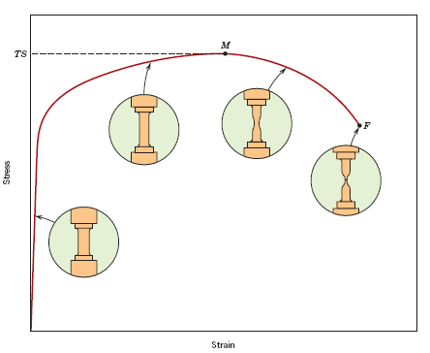
Tensile Strength, TS
• Maximum stress on engineering stress-strain curve.
TS
F = fracture or
ultimate
strength
Neck – acts as stress concentrator
σ_{y}
stress
engineering
Typical response of a metal
strain
engineering strain
• Metals: occurs when noticeable necking starts.
• Polymers: occurs when polymer backbone chains are
aligned and slip past one another.

Slide 21
Tensile Strength : Comparison
Metals/
Graphite/
Composites/
Alloys
Ceramics/
Polymers
fibers
Semicond
5000
C
fibers
3000
Aramid
fib
E-glass fib
2000
Steel
(4140)
qt
(MPa)
A
FRE
(|| fiber)
1000
W
(pure)
a
Diamond
GFRE
(|| fiber)
Ti
(5Al-2.5Sn)
a
C
FRE
(|| fiber)
Steel
(4140)
cw
Si nitride
Cu
(71500)
hr
Cu
(71500)
Al oxide
300
Steel
(1020)
Al
(6061)
ag
Room Temp. values
200
Ti
(pure)
a
Ta
(pure)
Al
(6061)
a
Si crystal
wood(|| fiber)
Based on data in Table B4,
Callister 7e.
a = annealed
hr = hot rolled
ag = aged
cd = cold drawn
cw = cold worked
qt = quenched & tempered
AFRE, GFRE, & CFRE =
aramid, glass, & carbon
fiber-reinforced epoxy
composites, with 60 vol%
fibers.
100
<100>
strength, TS
Nylon 6,6
Glass-soda
PC
PET
40
Concrete
PVC
GFRE
( fiber)
30
PP
C
FRE
( fiber)
H
DPE
A
FRE( fiber)
20
Graphite
L
DPE
10
Tensile
wood
( fiber)
1

Slide 22
Ductility
L
−
L
• Plastic tensile strain at failure:
%
EL
=
f
o
x 100
L
o
smaller %EL
E
ngineering
tensile
stress,
σ
larger %EL
A_{o}
L_{o}
A_{f}
L_{f}
Adapted from Fig. 6.13, Callister 7e.
Engineering tensile strain,
ε
A
-
A
• Another ductility measure:
=
o
f
%
RA
x
100
A
o

Slide 23
Toughness
• Energy to break a unit volume of material
• Approximate by the area under the stress-strain
curve.
E
ngineering
small toughness (ceramics)
tensile
large toughness (metals)
stress,
σ
very small toughness
(unreinforced polymers)
Engineering tensile strain,
ε
Brittle fracture: elastic energy Ductile fracture: elastic + plastic energy

Slide 24
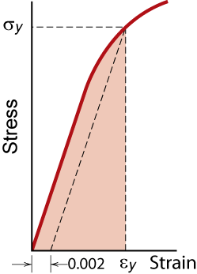
Resilience, U_{r}
Ability of a material to store energy
Energy stored best in elastic region
If we assume a linear stress-strain curve this simplifies to
1
U
≅
σ
ε
r
2
y
y
Adapted from Fig. 6.15, Callister 7e.

Slide 25
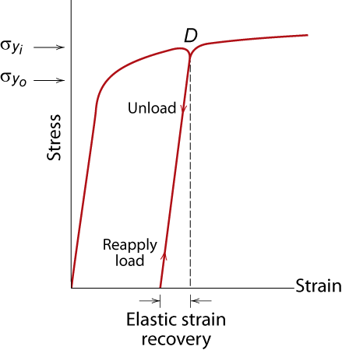
Elastic Strain Recovery

Slide 26
Hardness
• Resistance to permanently indenting the surface.
• Large hardness means:
--resistance to plastic deformation or cracking in
compression.
--better wear properties.
apply known force
measure size
e.g.,
of indent after
10 mm sphere
removing load
Smaller indents
D
d
mean larger
hardness.
most
brasses
easy to machine
cutting
nitrided
plastics
Al alloys
steels
file hard
tools
steels
diamond
increasing hardness

Slide 27
Hardness: Measurement
Rockwell
No major sample damage
Each scale runs to 130 but only useful in range 20-100.
Minor load 10 kg
Major load 60 (A), 100 (B) & 150 (C) kg
A = diamond, B = 1/16 in. ball, C = diamond
HB = Brinell Hardness
TS (psi) = 500 x HB
TS (MPa) = 3.45 x HB

Slide 28
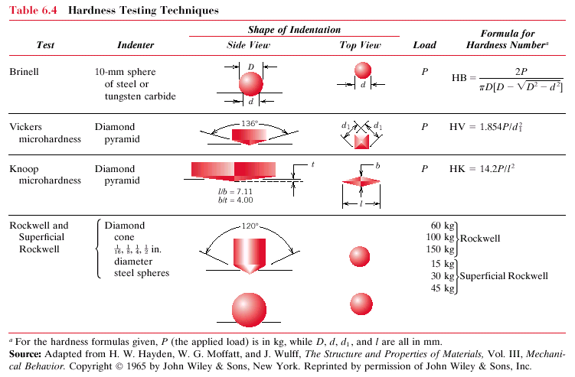
Hardness: Measurement
Table 6.5

Slide 29
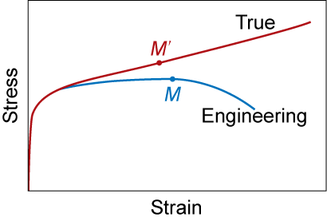
True Stress & Strain
Note: S.A. changes when sample stretched
True stress
True Strain
Adapted from Fig. 6.16, Callister 7e.

Slide 30
Hardening
• An increase in σ_{y} due to plastic deformation.
σ
large hardening
σ
y
1
σ
y
small hardening
0
ε
• Curve fit to the stress-strain response:
hardening exponent:
(
)
n
n =
0.15 (some steels)
σ
=
K
ε
T
T
to n =
0.5 (some coppers)
“true” stress (F/A)
“true” strain: ln(L/L_{o})

Slide 31
Variability in Material Properties
Elastic modulus is material property
Critical properties depend largely on sample flaws (defects, etc.); large sample to sample variability
Statistics
Mean
Standard Deviation
where here n is the number of data points
Notes:
All samples have same value
Because of large variability must have safety margin in engineering specifications

Slide 32
Design or Safety Factors
• Design uncertainties mean we do not push the limit
• Factor of safety, N
• Example: Calculate a diameter, d, to ensure that yield does
not occur in the 1045 carbon steel rod below. Use a
factor of safety of 5.
d
1045 plain
carbon steel:
σ
L
o
y
= 310 MPa
5
TS = 565 MPa
d = 0.067 m = 6.7 cm
F = 220,000N

Slide 33
Summary
• Stress and strain: These are size-independent
measures of load and displacement, respectively
• Elastic behavior: This reversible behavior often
shows a linear relation between stress and strain
To minimize deformation, select a material with a
large elastic modulus (E or G)
• Plastic behavior: This permanent deformation
behavior occurs when the tensile (or compressive)
uniaxial stress reaches σ_{y}
• Toughness: The energy needed to break a unit
volume of material
• Ductility: The plastic strain at failure

